Slide 1

Motion in a straight line
Lecture 2
Today…
Distance and displacement
Speed and velocity
Average, and instantaneous velocity
Average, and instantaneous acceleration
All found in University Physics: 2.2 – 2.4
Notes:
Today we are going to start looking at displacement, velocity and acceleration….
The simplest situation to study is a straight line..
I think you already have the hang of displacement in a staight line….a ruler..
Well look at velocity and the difference between average and instanteous velocity
Then look at acceleration… and the difference between average and instantaneous acceleration…
Also how to read graphs of velocity and acceleration, and some examples…
Take notice of the references in the textbook… it is a very good textbook ….. Color pictures

Slide 2
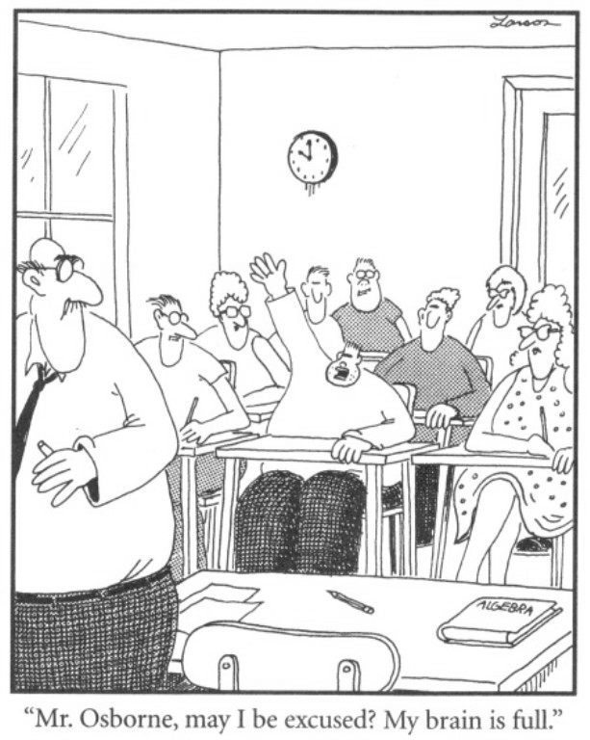

Slide 3
Review
Last lecture we looked at :
The difference between a vector and a scalar quantity. Vector notation.
Addition and subtraction of vectors
Components of vectors
Unit vectors. The scalar product or dot product
Notes:
Last lecture we looked at vectors. We learnt :
The difference between a vector and a scalar quantity – who remembers what it is ? (scalar just a magnitude, vector includes direction. Examples ? Scalar – time, temperature, Vector – velocity, force, displacement
The distinction between distance and displacement (distance just magnitude, displacement has magnitude and direction and goes from start to end so can be zero)
Addition and subtraction of vectors
Components of vectors
Unit vectors
The scalar product or dot product (if time)

Slide 4
Example- Adding vectors
Find A + B using component method if A has magnitude 5.0 at elevation of 60⁰ and B magnitude 3.0 at elevation of 30⁰ as shown below.
5.83
5
A
5.1
30⁰
B
3
30⁰
Notes:
Note that a dot product gives a scalar quantity.

Slide 5
Example- Adding vectors (cont)
5.83
5.83
5.1
5.1

Slide 6
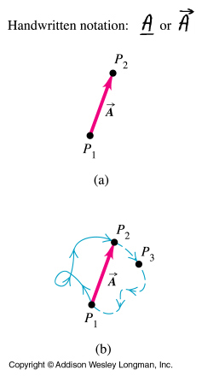
Distance scalar Displacement is a vector
If P₂ is at P₁ then displacement is zero but distance travelled still has a value
Notes:
Before we talk too much about velocity we better go back and look at the displacement.
Remember that displacement is a vector.
If we go from P1 to P2 as in the top diagram the velocity makes sense. All in one dimension…
However this doesn’t work very well when we are talking about the V8 racing cars….
They travel around the track all day and go back to the starring line….
Their average velocity for the day is 0….Whats wrong with this….???
Need to define another quantity which describes the velocity, without taking into account direction… this is speed. .
. It is distance divided by time, rather than displacement/time…
Here we have the particle at p1 at t1, p2 at t2, just like on the graph. If P2 say was at the same point as P1 then there would be zero displacement and the average velocity would be zero ! Speed is something different. Speed has magnitude only, it is a scalar quantity. Average speed is distance travelled divided by time, not displacement divided by time.

Slide 7
Speed and velocity
Speed is measured using distance and time
Velocity is measured using displacement and time
So speed is a scalar, velocity is a vector
For example 15 km/hour is a scalar. 58.4 m/s in a northerly direction is a velocity and is a vector

Slide 8

Example - Average velocity vs speed
Ian Thorpe’s personal best for 100 m freestyle in a 50 m pool in 2001 was 48.81 seconds.
His average SPEED would have been 2.05 m/s
His average velocity however is zero m/s!
Notes:
To give you an example, Ian Thorpe’s personal best for 100m freestyle in a 50 m pool in 2001 was 48.81 seconds. He would have swum from one end of the pool to the other and back again. His average SPEED would have been distance travelled divided by time, 100m/48.81seconds=2.05 m/s His average velocity however is displacement divided by time which is zero (he ended up where he started) divided by 48.81 which is zero m/s!
The difference comes about because Speed is a scalar quantity with magnitude only, velocity is a vector quantity with magnitude and direction.

Slide 9
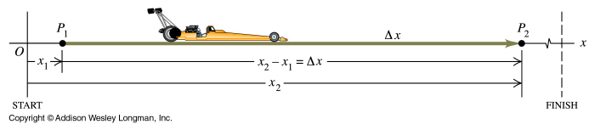
Average velocity
Average velocity is the displacement divided by the time interval
Units m/s
Notes:
First definition is average velocity
It is defined as difference in x x2-x1 divided by difference in time…t2 –t1
It is a vector becaue the displacement is a vector…
Average velocity is difference in x divdied by difference in time…..
Here we’re looking at the average velocity between point P1 and P2.
EXPLAIN THE EQUATION and delta sign.
Note that the average velocity depends on which time interval used

Slide 10

Example- Find the average velocity.
stop
x₁=5 m
t₁= 12 sec
x₂=1680 m
t₂ = 185 sec
Only includes initial and final conditions, the average does not have details about the path or events. Such as stopping or drive over the mountain.
Notes:
If the car is moving in the positive x direction you can see from the equation that the average velocity will be positive.
So average velocity is the difference in displacement, divided by the difference in time over a reasonable distance.
Notice the units are m/s.
Average velocity is the distance travelled divided by the time taken…. If the car goes faster or slower (like a stop sign) this is averaged..
Another way of looking at average velocity is the hare and the totoise. …

Slide 11
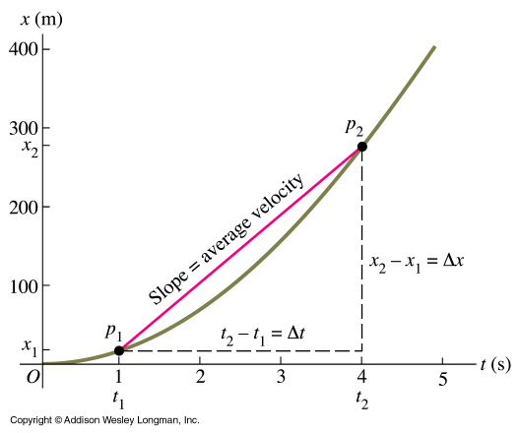
Average velocity from displacement graph
V_{av}=Δx/Δt= (280-20)/(4-1)
= 260/3 = 86.7m/s
Notes:
Here is a graph plotting distance travelled on the y axis and time on the x axis…
Since average velocity is difference in distance… divided by difference in time. It would be the gradient of a line drawn from p1 to p2 in the diagram….
Notice that the line deviates from this straight gradient…. Why?
The object may change its velocity( in this case it is speeding up)… however a lot of that detail about speeding up or slowing down is lost…. And for average velocity we are only taking two points…. Initial and final positions.
This diagram shows the sort of graph you would plot. TALK ABOUT X AND t, P1 AND P2, X1 ETC.
On the graph you can see how to calculate the average velocity …remember we’re interested in displacement divided by time interval. Our graph shows where the particle starts and where it ends…it starts at x=x1 and ends at x=x2. So we can calculate displacement, simply as x2-x1..SHOW DELTA X.
The time interval is simply t2-t1, ie final time when at x2 minus initial time when at x1.This is delta t.
So you can see that the average velocity is simply delta x divided by delta t which is the slope of the line joining the initial and final points on the graph, where p1 is initial and p2 is final.

Slide 12

Example - Average speed
It takes Penny 37.0 seconds to drive along a 1.2 km airport runway, from a standing start at south end to the North end.
What is her average speed in completing this distance?
To become a velocity this speed needs to include a direction.
Average velocity v=32.4m/s in a due North direction.
Notes:
In this example it takes Penny 6 hours to drive to Sydney, covering 550 km….She averages 91.7 km/hour.
This doesn’t take into account the slowing down through speed limit signs- or stops. But only two points- the beginning and end of the journey….
So wait a minute- if we only measure the beginning and end of journey…

Slide 13
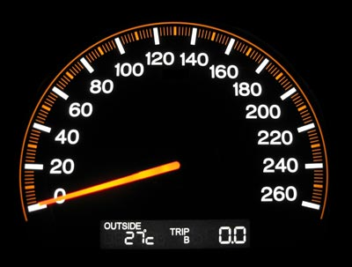
Instantaneous velocity
Instantaneous velocity is the limit of the average velocity as the time interval approaches zero. It is the instantaneous rate of change of position with time
Notes:
To describe the motion of a particle in more detail we need to know the velocity at specific instants of time, an instant being a precise time like at t=1second. This velocity is called instantaneous velocity, the velocity at that instant of time.
The way to do this is to take the equation for average velocity and shrink the time interval to as close to zero as you can. So we shrink delta t to close to zero and of course delta v will also shrink. The ratio will still have a value. You may recognise this as being a method used in calculus. The limit of delta x on delta t as delta t goes to zero is called the derivative of x with respect to t, written as dx/dt.
Instantaneous velocity, like average velocity, is a vector quantity, with both magnitude and direction.

Slide 14
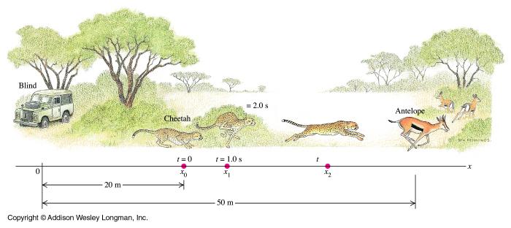
Example 2.1 Average and instantaneous velocity
Notes:
Heres an example…. Of Average and instantaneous velocity….

Slide 15
Example 2.1Average and Instantaneous velocity (cont)
a) Find the displacement of the cheetah during the interval between t = 1.0 sec and t = 2.0 sec.
At t = 1 sec……x =20+5*1*1= 25 m
At t = 2 sec…..x = 20+5*2*2= 40 m
Displacement = 40 m – 25 m = 15 m in the positive x direction
b) Find the average velocity during this time interval.
v_{av}=Δx/Δt=(40 m– 25m) /(2s – 1s)=15 m/s

Slide 16
Example 2.1Average and Instantaneous velocity (cont)
c) Find the instantaneous velocity at time t = 1.0 sec, by taking Δt = 0.1 sec, then Δt = 0.01 sec.
d) Derive a general expression for the instantaneous velocity as a function of time, and from it find v, at t = 1.0 sec and t = 2.0 sec.
v_{av}= dx/dt = 10t. At t = 1sec v = 10m/s. At t = 2 v = 20m/s
Notes:
If we shrink the deltas up ……and find a value closer to the instantaneous velocity at t = 1 by taking delta t= 0.1 then 0.01 sec…

Slide 17
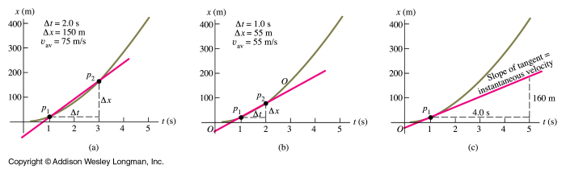
Instantaneous velocity from a graph
As P₂ approaches P₁ the slope of the line between P₁ and P₂ becomes the tangent at point P₁ and its slope gives the value for instantaneous velocity at P₁ ….. On a graph of position as a function of time for straight-line motion, the instantaneous velocity at any point is equal to the slope of the tangent to the curve at that point
The derivative gives the slope.
Notes:
So what has happened…
Now we know what instantaneous velocity is, how do we get this from a graph ? When we looked at average velocity we drew a graph of x vs t. The average velocity was simply the slope of the line joining the initial and final points on the graph, where p1 was initial position and and p2 was final position. We do the same for instantaneous velocity but we move P2 to P1 which is the same as making delta t got to zero. At the limit where delta t goes to zero the slope of the line p1p2 equals the slope of the line tangent to the curve at point p1. The slope of this tangent is the instantaneous velocity at that point.
As P₂ approaches P₁ the slope of the line between P₁ and P₂ becomes the tangent at point P₁ and gives the value for instantaneous velocity at P₁
On a graph of position as a function of time for straight-line motion, the Instantaneous velocity at any point is equal to the slope of the tangent to the curve at that point
Both delta x and delta t become very small, but not necessarily their ratio….
In the language of calculus the limit of delta x/delta t as t approaches zero is called the derivative of x with respect to t and is written dx/dt.

Slide 18
Average acceleration
Average velocity is the displacement divided by the time interval
Average acceleration is the change in velocity divided by the time interval
Units of acceleration are m/s²
Notes:
So that’s avererage and instanteneous velcocity….What about acceleration..
Velocity describes the rate of change of position with time, acceleration describes the rate of change of velocity with time. All the things we learnt about velocity are similar for acceleration except that we’re dealing with rate of change of velocity now, not position. So average acceleration is a vector quantity and it is easy to see that the equation for average velocity is similar to the one for velocity, putting v where x was.
Explain delta v over delta t bit.
The units are m/s².
Acceleration describes how the speed and direction of motion change over time. Note it’s direction too (as velocity is a vector with magnitude and direction and we’re looking at change in velocity) so even if say an object moves at 6 m/s at t1 and then 6 m/s at t2, if the direction has changed then there is acceleration.

Slide 19

Notes:
When you don’t have the appropriate velocity- a computer driven plane

Slide 20


Slide 21

This Bear Suffers from acceleration due to changes in velocity

Slide 22
Instantaneous acceleration
Instantaneous acceleration is the limit of the average acceleration as the time interval approaches zero; it is the instantaneous rate of change of velocity with time
Notes:
When we found instantaneous velocity we took the limit of the average velocity as the time interval approaches zero to give us the instantaneous velocity. We do the same for instantaneous acceleration. We’re just making the time over which we measure the change in velocity to be so small that it is as if we’re looking at one point in time.This gives us the acceleration at a specific instant.
Instantaneous acceleration is the limit of the average acceleration as the time interval approaches zero; it is the instantaneous rate of change of velocity with time
It is the derivative of v with respect to t, written as dv/dt.
Instantaneous acceleration, like average acceleration, is a vector quantity, with both magnitude and direction.

Slide 23
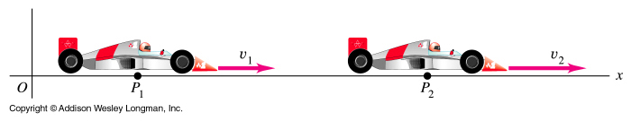
Example2.3- Instantaneous acceleration
Notes:
Let’s go through an example. You’ll see that it is very similar in terms of method to the one we did about average and instantaneous velocities.

Slide 24
Example 2.3 Instantaneous acceleration (cont)
a) Find the change in velocity of the car in the time interval between t =1.0 sec and t = 3.0 sec.
At t = 1……v = 60.5 m/s At t = 3…..v = 64.5 m/s
b) Find the average acceleration in this time interval
a_{av}= Δv/Δt = 4/2 = 2.0 m/s²

Slide 25
Example 2.3 Instantaneous acceleration (cont)
c) Find the average acceleration at time t=1.0 sec by taking Δt to be first 0.1 sec, then 0.01 sec.
d) Derive an expression for the instantaneous acceleration at any time, and use it to find the acceleration at t = 1.0 sec and t = 3.0 sec.
a = t When t = 1…a = 1 m/s² When t =3…a =3 m/s²

Slide 26
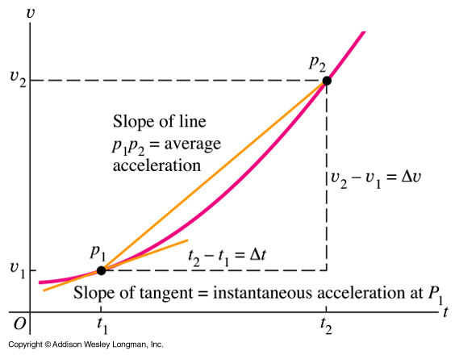
Instantaneous acceleration from a graph
On a graph of instantaneous velocity as a function of time, the instantaneous acceleration at any point is equal to the slope of the tangent to the curve at that point
Notes:
So whats happening…
On a velocity graph the acceleration is the gradient…. Average acceleration is from P1 to P2
As the disance between P1 and P2 becomes smaller the accelration tends towards the instataneous acceleration at P1….
Reducing in value….

Slide 27
Review: What does the displacement time graph look like?
Notes:
So just like the displacement time graph to find average and instantaneous velocity….

Slide 28
Review: What does the velocity time graph look like?
Notes:
The velocity time graph is a similar thing to caculate average and intantaneous acceleration.

Slide 29

Example: A dizzy turkey
A turkey moves according to the following relationship:
x = 5 – 2 t + 0.5 t²
Calculate its velocity and acceleration at a time t = 5 s.
Differentiate v = -2 + t m/s a = 1 m/s²
At t = 5 sec
v = 3 m/s acceleration always 1m/s²

Slide 30
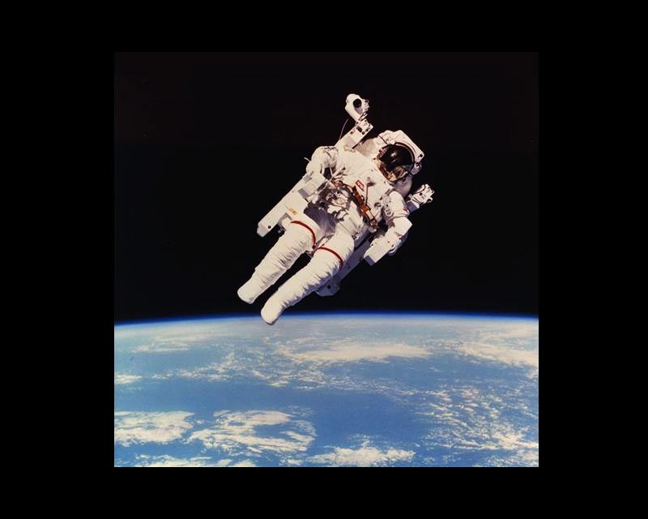
Lets look at an object falling from afar.
An astronaut floats near the space shuttle.
Notes:
Lets look at acceleration ….
When astronauts are in the space station – they have no gravity- does this mean they are outside the earths gravitational field?
Outside the Earths Gravitational field there is no gravity…. Is this correct???

Slide 31

However around the surface of the Earth the acceleration is fairly constant so a velocity time graph is a straight line.
Gradient = 9.8 m/sec²
v
m/s
t sec
Notes:
What would the gradient be 9.8 m/s2

Slide 32

Remember…
Distance is a scalar. Displacement is a vector.
Speed is a scalar. Velocity is a vector.
Average velocity=Δx/ Δt
Instantaneous Velocity = dx/dt as t→0….
… the derivative of x w.r.t t
Average acceleration = Δv/ Δt
Instantaneous acceleration = dv/dt as t→0…. …the derivative of v w.r.t t
Notes:
yoda

